Slide 2
Get more “R” out of your OKRs.
Results
Goals
Roles
and
.
,
Reimagined.
info@goalytics.io
Notes:
We are all about th R in the okrs nd we compae ourselves with the smart watch
“Thanks for having us. Today we want to talk about one thing: how NFDC can get more realized results out of the strategies, goals, and projects you already have.
You’re already doing the hard work—planning, prioritizing, delivering major facilities programs. Goalytics is about tightening the connection between those plans and the actual outcomes in your portfolio.
We’ll focus on three ideas: goals, roles, and results — and how a more disciplined, data-driven OKR practice can unlock value across Kaiser’s facilities and workplace investments.”

Slide 3
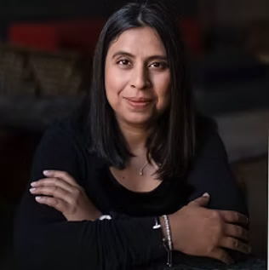
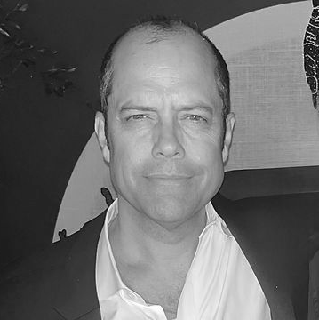
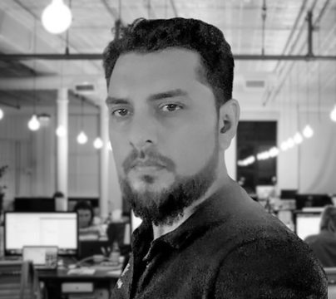
Who We Are
Experience Getting Results
NIDA GILLIO, M.CRE.
CEO/Founder
STEPHEN BUTLER, Ph.D.
CMO
UMAIR KHAN, B.Eng.
CTO
San Francisco
Workplace & change strategy
Founder/CEO, Caryatid
Calgary/San Francisco
Ex-BCG/F500 Strategy
Advisor, Invisible Technologies
Dubai
CTO, Digital Gravity
Award-Winning Full-Stack Development
+ A global team from across the U.S. to UAE
Notes:
We bring three things together: large-scale workplace programs, strategy and OKR design, and AI product build.”
“Our goal isn’t a shiny tool; it’s a repeatable management system for your capital program.
“Very briefly on us. Nida brings deep experience in workplace, culture, and change and expreince to connect strategy to execution—how environments and programs land with people. Stephen brings strategy experience from advising large enterprises. Umair brings the full-stack technology capability to actually build and scale platforms that work in complex organizations.
Together, we’re focused on one thing that matters to this group: turning your existing capital and workplace efforts into repeatable, measurable, and improvable results across NFDC.”

Slide 4
What You’ll Take Away
Who We Are
Why Goalytics
Our USP (POV)
How It Works (Demo)
Next Steps
Notes:
Agenda
“We’ll cover: the problem we see, our approach, how Goalytics works, and what this could mean in dollars and impact for NFDC.”
“We’ll end with a simple, low-risk pilot you could start in 2026.”
“Here’s what you can expect from this session.
First, why Goalytics – the problem we see in large capital programs like NFDC. Second, who we are and how our backgrounds in workplace, strategy, and AI come together. Third, our point of view on OKRs and how they should connect strategy to execution.
Then, we’ll show you how the platform works, share a view of the ROI and opportunities for NFDC, and finish with a minimum viable pilot we could run together in 2026.”

Slide 5


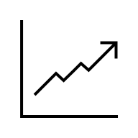
Why We’re Here
OKRs are Powerful, But Hard to Manage
The Challenge
Our Solution
Most OKRs are poorly organized.¹
Goals
Rigorous, AI-supported structuring.
Execution lacks discipline (setting and forgetting).²
Roles
Clear, engaging business flows.
Tasks are conflated with results.³
Results
Meaningful data and analytics.
“I spend half my time fixing what should be saving time.” CPG Manager
OKR discipline → 25% higher growth: HBR
Notes:
“OKRs and goals are everywhere, but they’re hard to manage at scale across sites, vendors, and years.”
“We’ll show how to make your priorities, projects, and outcomes easier to align, own, and measure.”
“Most organizations – including Kaiser – use some form of goals and OKRs. The challenge is that, in practice, they’re often poorly organized, they get set and forgotten, and they drift into long lists of tasks rather than clear, measurable results.
For NFDC, that shows up as: lots of initiatives, lots of activity, but not always a clean line of sight to value for members and clinicians.
Our solution is to bring rigorous structuring, clear business flows, and meaningful analytics to your existing goals so they’re easier to own, track, and improve at every level.”

Slide 6
Potential: Even More Meaningful Results
What the Research Shows
40
30
%
Reduction in manual processing ⁴
%
Reduction in management overhead⁶
25
%
25
Higher growth²
20
%
Better goal achievement rates⁵
%
Increase in team productivity⁷

Slide 7
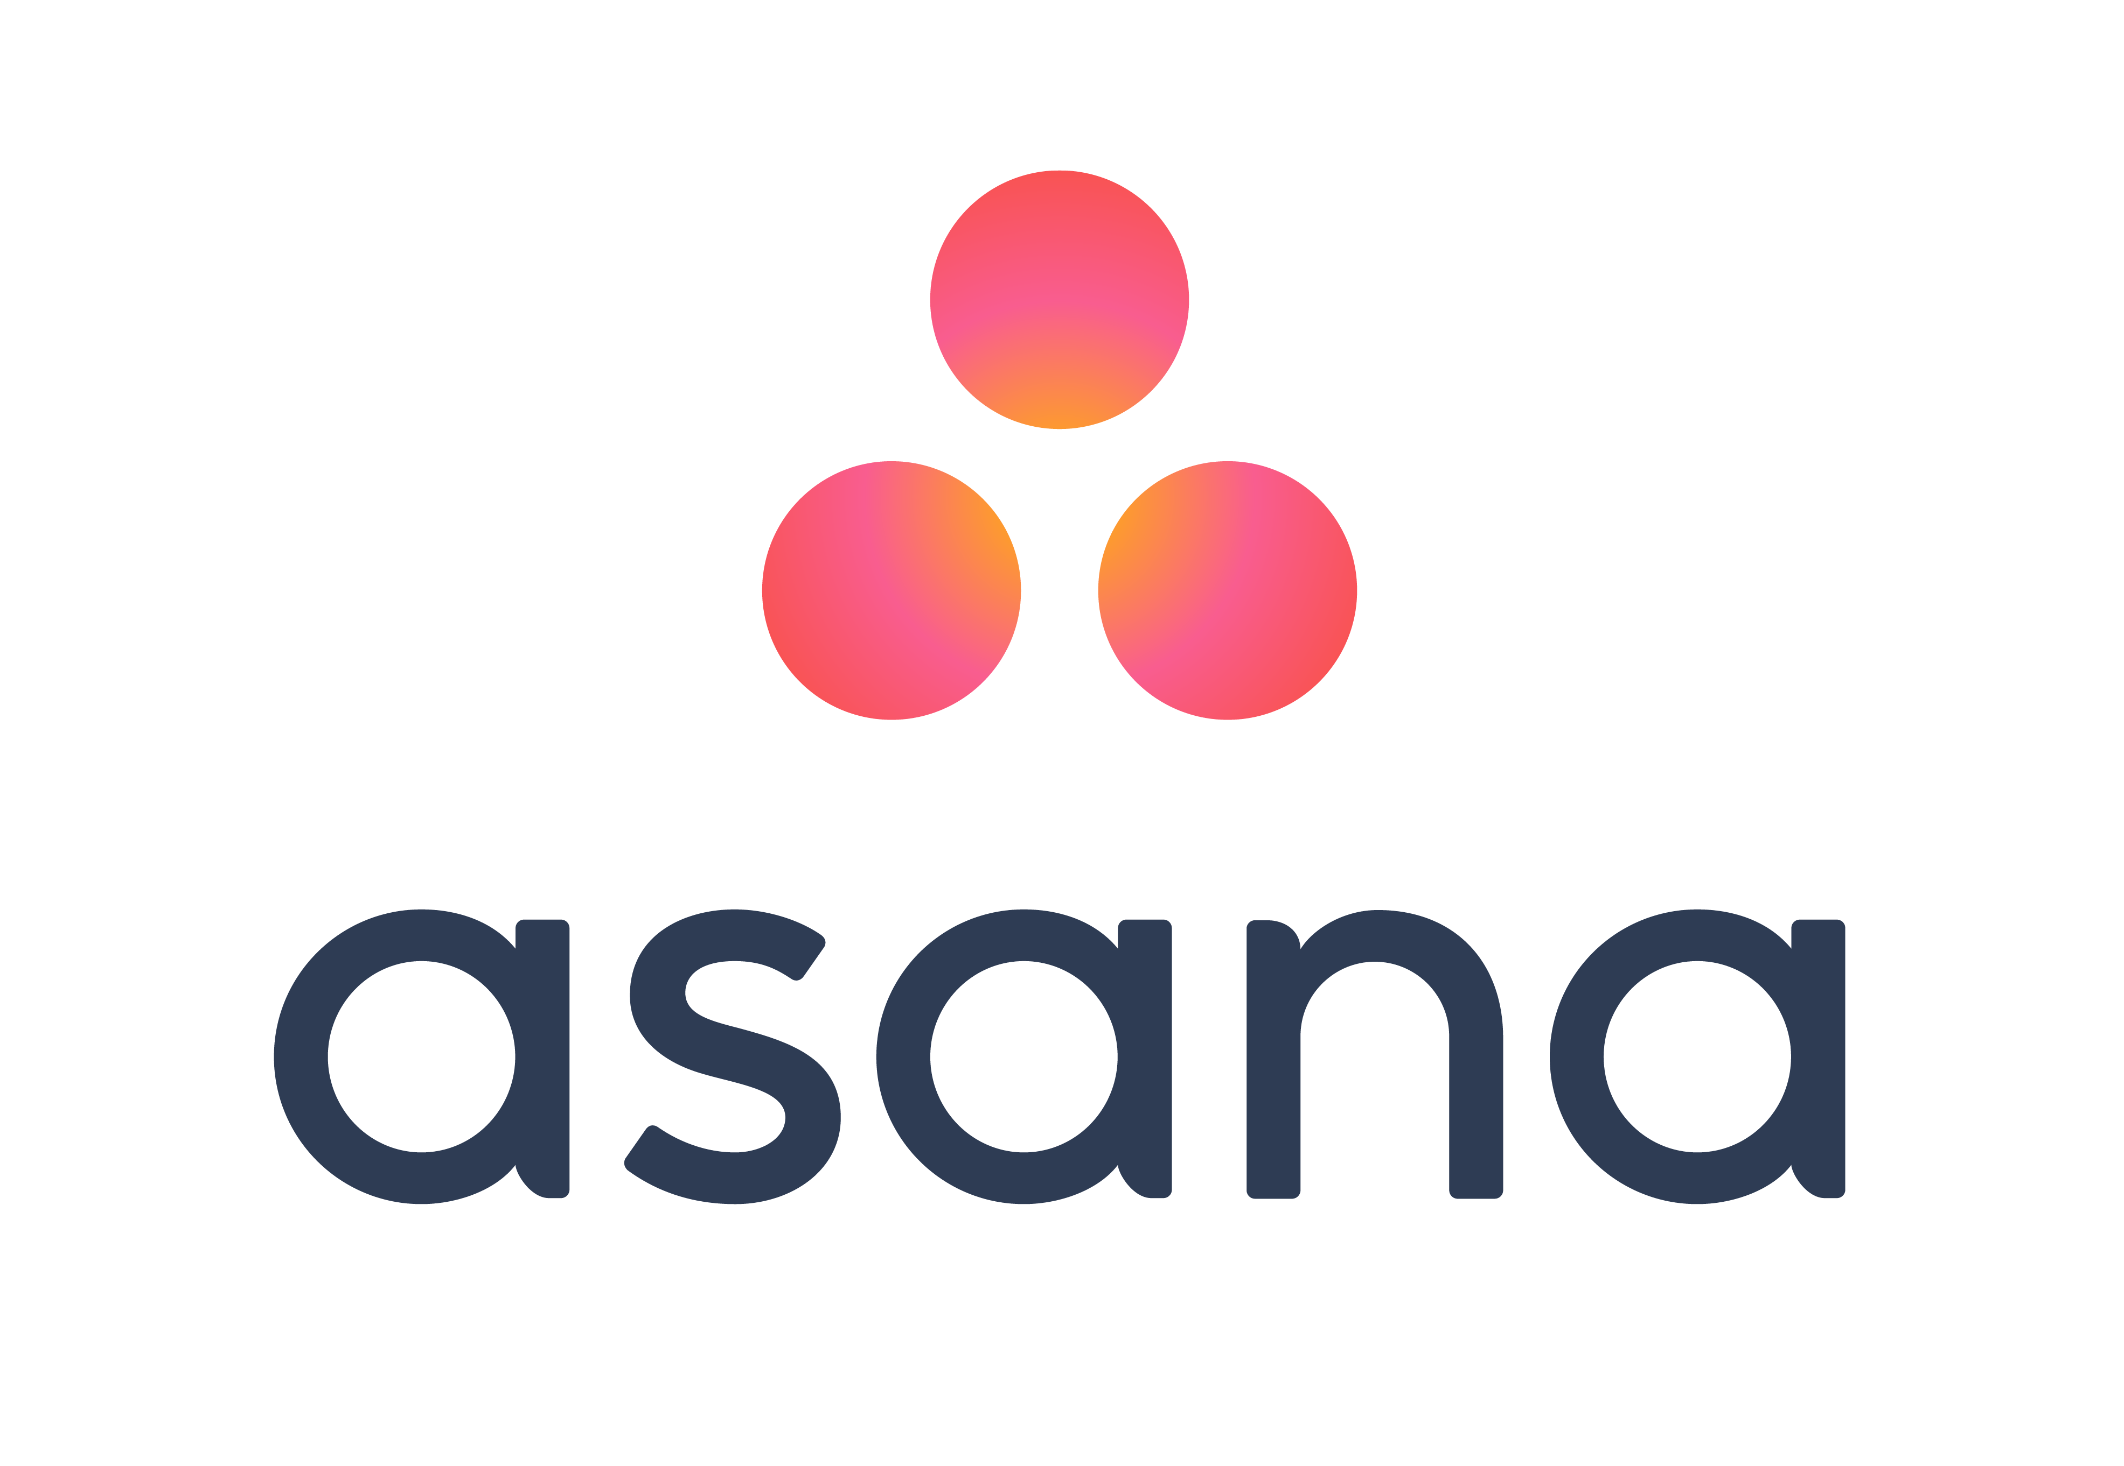

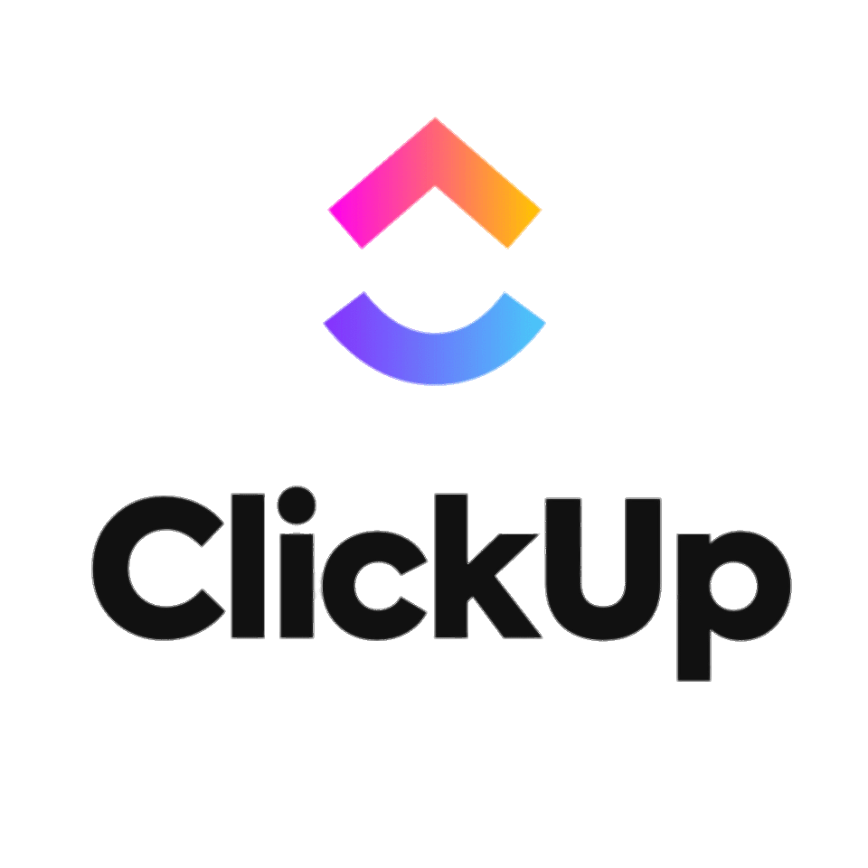

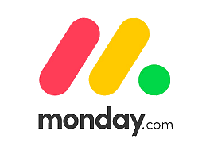
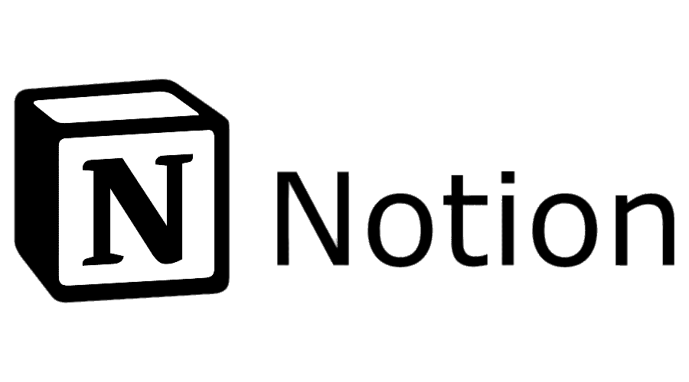

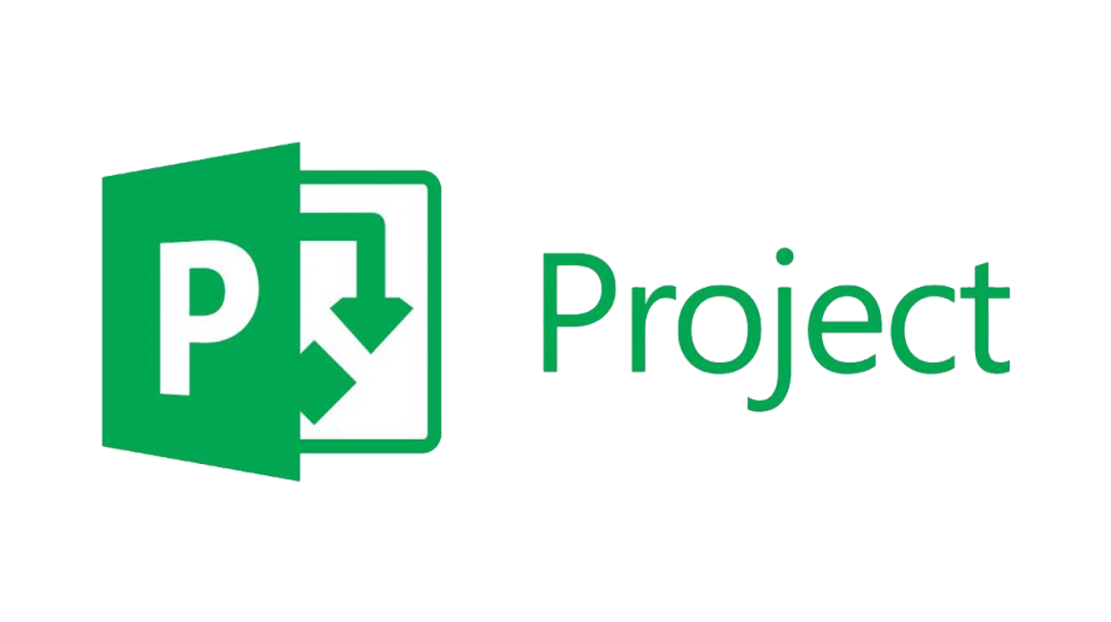
How Accountability Drives Advantage
Missing Link Between Strategy and Outcomes
Goals
Roles
Results
Develop hypotheses
Convert into and track OKRs
Manage execution
Learn
Turn outcomes into advantage
Notes:
Start with Goals (left) “We start here with our goals – the strategic hypotheses that come out of planning sessions: what we think will move the needle.”
Jump to Results (right) – the gap “On the other side we have results – the real work being managed day to day in tools like Asana, ClickUp, monday.com, Notion, Project. The problem is, these tasks and projects can easily drift away from the original goals. That gap is the missing link between strategy and outcomes.”
Introduce Roles & GOALYTICS (center) “GOALYTICS sits in the middle with roles. We translate those high-level goals into clear OKRs, assign ownership, and connect them to the work already happening in those tools—so every project knows which goal it serves and who’s accountable.”
Close the loop with Learn (bottom) “Because goals, roles, and results are connected, we can learn from what actually happens—see what worked, what didn’t, and feed that back into the next round of goals.”
Single takeaway “In short: goals set the direction, execution tools do the work, and GOALYTICS provides the accountability layer that ties them together and turns outcomes into advantage.”

Slide 8
Our USP Starts With a POV
OKRs Need Strategic Context
Priorities (Company)
Goals (Team)
Objectives (Projects)
+
Key Results (Projects)
The WHY
The WHAT
The HOW
All Objectives need Key Results (= an OKR)
Every Priority has at least one Goal
Every Objective has at at least one KR (ideally, two)
Multiple Goals can support a Priority
Every Goal needs at least one OKR
Goals can support multiple Priorities
Most Goals have multiple OKRs
The driver tree isn’t always tidy or elegant
OKRs can serve multiple goals (but it’s rare)
Notes:
Key Results (right) “We start on the right with Key Results – the day-to-day numbers we live with in NFDC: opening dates, budget, safety, quality checks. This is the work you feel in your projects.”
Objectives “Those KRs roll up into Objectives – things like ‘deliver this MOB ready for patients’ or ‘standardize this design kit across regions.’ They describe what success looks like for a project this year.”
Goals (middle) “Those Objectives support our bigger NFDC Goals – reliably delivering capital projects, creating great care environments, and being a trusted partner to the regions.”
Priorities (left) “All of that ladders up into a few Kaiser Priorities – access, affordability, quality, and caregiver experience. That’s the real ‘why’ behind our work.”
Single takeaway: “For NFDC, every Key Result on the right should clearly connect back to a Kaiser priority on the left—if we can’t see that line, we should question why we’re doing it.”
“Think of a chain: Kaiser priorities → NFDC goals → project-level objectives → key results.”
“Today, this chain exists, but it’s often implicit. We make it explicit, traceable, and visible.”
Priorities are the ‘why’; goals are the multi-year ‘what’; objectives are the annual ‘how’; key results are the proof.”
“Key results focus on outcomes, not task lists, and each has a named owner.”
“An OKR is only useful if everyone can see the higher-level priority it serves.”
“We connect each OKR upward to Kaiser/NFDC priorities and downward to specific projects and teams.”

Slide 9


How Goalytics Works
Structure + Knowledge = Advantage
Goals
Roles
Results
Structure
(“How work is organized”)
Knowledge
(“What the team actually thinks, decides & learns”)
Org/BU Strategy
Team Plan
Project Plan
Analysis
Priorities
Goals
OKRs
Insights
Notes:
1. Structure + Knowledge (first)
“We start with two ingredients: Structure—how work is organized—and Knowledge—what people actually think, decide, and learn on NFDC projects. Goalytics connects those two.”
2. Org Strategy → Org Priorities
“First, we take Org Strategy and turn it into a small set of Org Priorities—the big bets leadership is making.”
3. Team Plan → Goals
“Those priorities become an NFDC Team Plan and clear Goals for our major work streams, like stakeholder engagement or pre-engineered MOB design.”
4. Project Plan → OKRs
“Each goal then has a Project Plan with specific OKRs, so every initiative knows exactly what success looks like this year.”
5. Analysis → Insights
“As work happens, Goalytics pulls the data into Analysis and turns it into Insights—what’s on track, what’s stuck, and what we’re learning across projects.”
6. Insights loop back to Strategy
“Those insights loop back into Org Strategy and Priorities, so each planning cycle is smarter than the last.”
7. Goals / Roles / Results bars appear
“Across the top you can see how Goalytics runs this as a system: clear Goals, explicit Roles, and visible Results—so NFDC turns everyday project work into a repeatable advantage.”

Slide 10
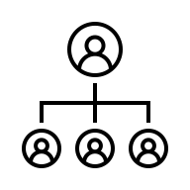

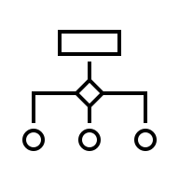

Key Features
What We’ll Demo
Configure org
Set goals
Design OKRs
Report results
Analyze insights
Powered by GI (Goalytics Intelligence)
Notes:
Intelligent Planner “Turn Kaiser priorities into clear NFDC objectives and KRs, fast.”
Active Collaboration “Lock in OKR roles and automate the check-ins and reporting.”
Progress Tracking “See real-time project status and updates in one place.”
Actionable Insights “Spot risks early, see patterns, and capture learnings.”
Single takeaway “One loop for NFDC: plan, execute, see progress, and learn—without extra admin.”
Most teams live in a ‘manual and solo’ world — each leader reinventing the wheel.”
“We move NFDC to ‘collaborative and AI-assisted’ — a shared structure, with smart support baked in.”
For leaders in this room, it’s a way to turn a messy set of goals, dashboards, and reports into a single, intelligent view of how your strategy is performing in practice.”

Slide 11
Demo

Slide 12
Roadmap
Version
1.0
2.0
3.0
4.0
Feature Set
MVP
POC
+ SaaS
+ Enterprise On Premise
Obj + KR
Metric Target Value/Time
Document Uploads
Internal Organizational Context
OKR Builder
Solo
+ Collaborative
+ Fully Automated
Agentic
Flows
Programmed
AI Chat
Intelligent Learning
Dynamic
Intelligence
Basic
Enhanced
Intelligent Diagnostic
Predictive
Analytics
Team Chat
Reactions & Collaboration
Interactive boards
Audio & Video Calling
Engagement

Slide 13
🤔
“Ideas are easy.
Execution is everything.”
John Doerr
👍
info@goalytics.io

Slide 14
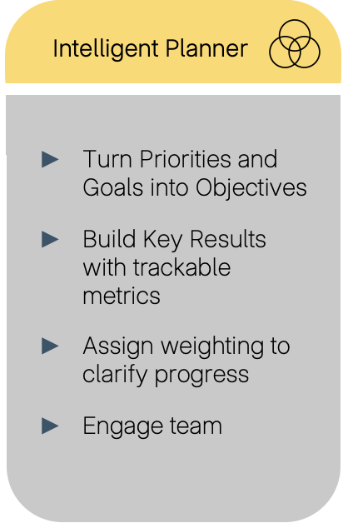
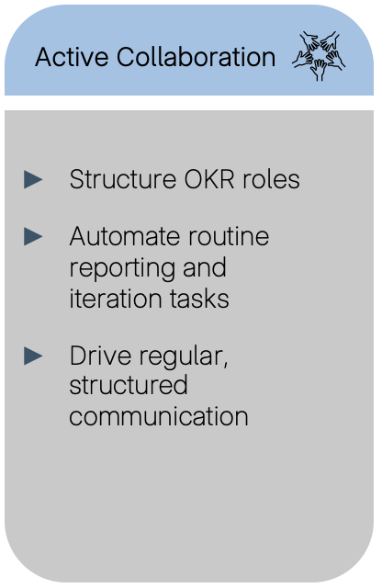
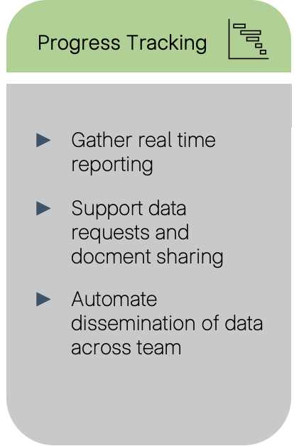
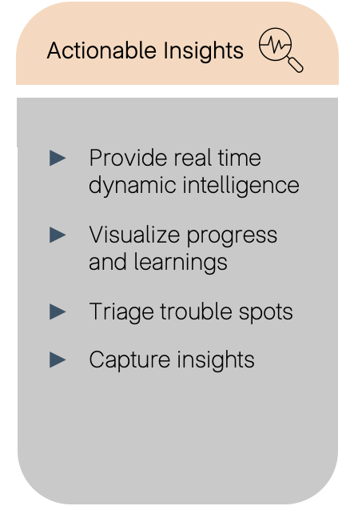
Key Features
What We’ll Demo
Powered by GI (Goalytics Intelligence)
Notes:
Intelligent Planner “Turn Kaiser priorities into clear NFDC objectives and KRs, fast.”
Active Collaboration “Lock in OKR roles and automate the check-ins and reporting.”
Progress Tracking “See real-time project status and updates in one place.”
Actionable Insights “Spot risks early, see patterns, and capture learnings.”
Single takeaway “One loop for NFDC: plan, execute, see progress, and learn—without extra admin.”
Most teams live in a ‘manual and solo’ world — each leader reinventing the wheel.”
“We move NFDC to ‘collaborative and AI-assisted’ — a shared structure, with smart support baked in.”
For leaders in this room, it’s a way to turn a messy set of goals, dashboards, and reports into a single, intelligent view of how your strategy is performing in practice.”

